Slide 1
2023-2024 IPEDS Update
Slides available at https://ark-ir.org
Eric Atchison
Vice President for Strategic Research

Slide 2
Agenda
2023-24 Data Collection Calendar
2023-24 Data Collection Changes
IPEDS Listserv → IPEDS Knowledge Exchange
Recent IPEDS Technical Review Panels
Upcoming Data Topics
IPEDS Summary Tables Data Tool
Slide deck available at: https://ark-ir.org/meetings.php

Slide 3
2023-24 Data Collection Calendar

Slide 4
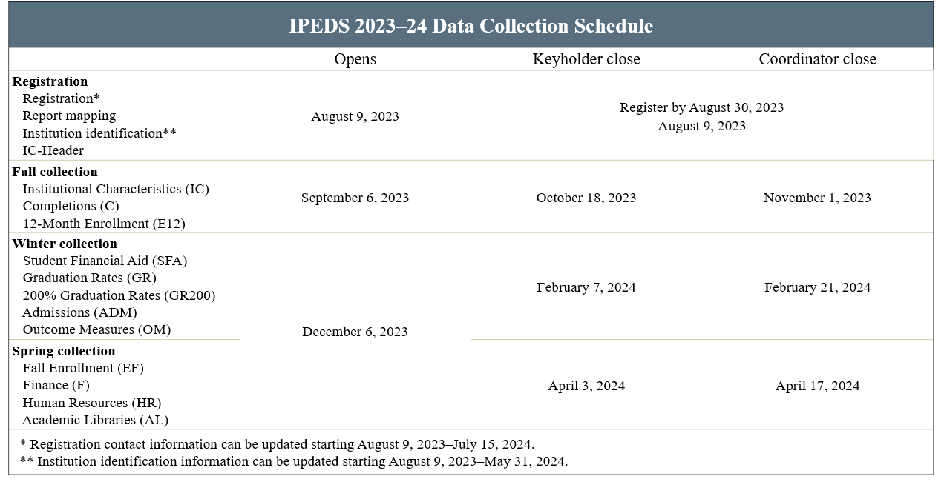
2023-24 Data Collection Schedule

Slide 5
2023-24 Data Collection: Other Important Dates

Slide 6
2023-24 Data Collection Changes

Slide 7
Dual Enrollment: Background for 2023–24 Changes
Improving IPEDS Data Collection on High School Students Enrolled in College Courses
https://nces.ed.gov/ipeds/pdf/NPEC/data/NPEC_Paper_IPEDS_High_School_Students_and_College_Courses_2017.pdf
Dual Enrollment TRP #63
https://edsurveys.rti.org/IPEDS_TRP_DOCS/prod/documents/TRP63_Summary.pdf

Slide 8
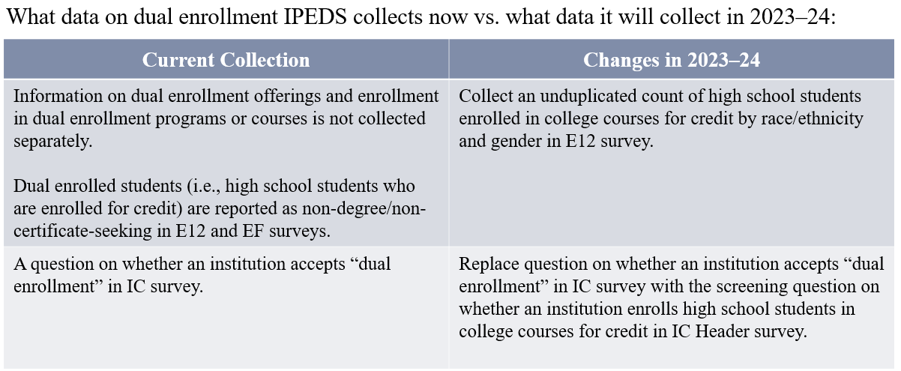
Dual Enrollment: Previous vs. 2023–24 Changes

Slide 9
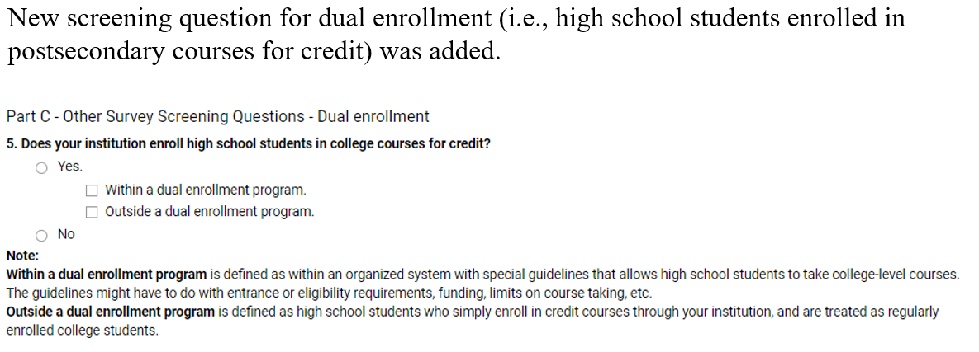
Dual Enrollment Changes: IC Header

Slide 10
Dual Enrollment Changes: IC

Slide 11
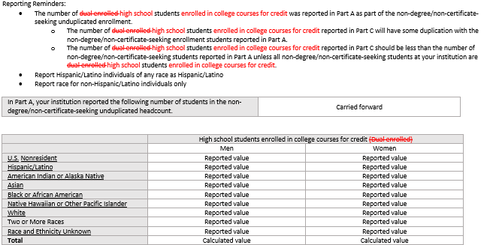
Dual Enrollment Changes: E12 (New Part C)

Slide 12
Fall Enrollment: Retention Rate for First-Time Bachelor’s Degree–Seeking Students
Part E: Retention Rates for First-Time Bachelor’s Degree–Seeking Student Cohort
Retention rates examine the percentage of first-time bachelor’s degree (or equivalent) seeking students enrolled in the fall of the prior year that are still enrolled in the fall of the current year or have completed their bachelor’s program in that time.
Total students retained = students from the Fall 2022 cohort who are still enrolled as of Fall 2023 + students from Fall 2022 cohort who completed their bachelor’s program as of Fall 2023.
(Students from the Fall 2022 cohort still enrolled as of Fall 2023 + Students from Fall 2022 cohort who completed their bachelor’s program as of Fall 2023)/(Adjusted Fall 2022 cohort) *100

Slide 13
Clarifying Inclusion of Reporting Incarcerated Students
Survey | FAQ
Fall Enr, 12-Mo Enr. | Should incarcerated students be included in enrollment reporting? Yes, include all students enrolled for credit even if enrolled at off-campus locations (e.g., federal or state penal institution).
Human Resources | Should staff providing instruction or services for incarcerated students be reported in HR? Yes. Include all staff who provide instruction or services for incarcerated students and who are paid for these services directly by their institution.
Completions | Should recognized postsecondary credentials awarded to incarcerated students be reported? Yes, all recognized postsecondary credentials awarded by your institution should be reported, including those conferred to incarcerated students.
Outcome Measures, Grad Rates | Should incarcerated students be in included in OM/GR cohorts? Yes, include incarcerated students when establishing cohorts.

Slide 14
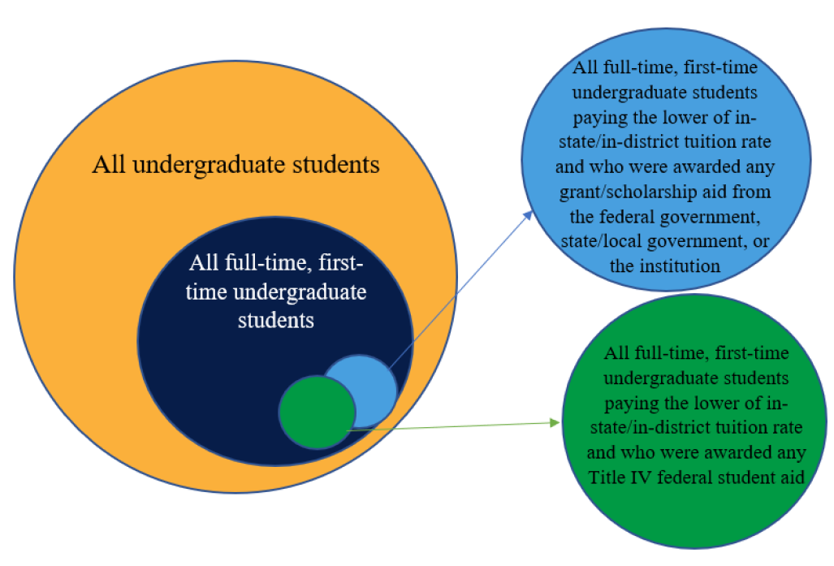
SFA: Removed “Groups” terminology

Slide 15
IPEDS Listserv → IPEDS Knowledge Exchange

Slide 16
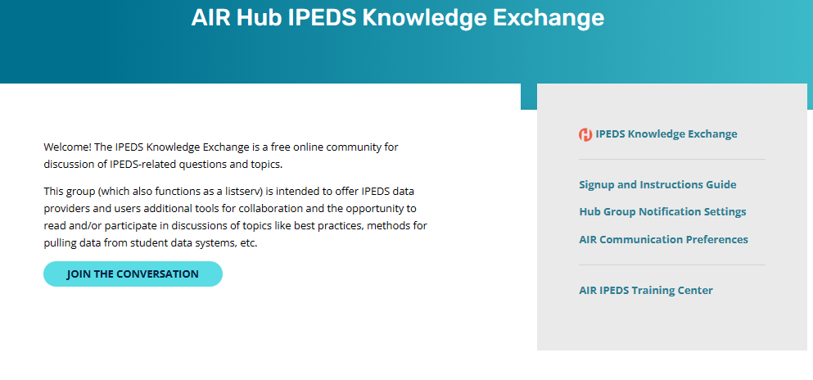
IPEDS Listserv Transition to IPEDS Knowledge Exchange
IPEDS Listserv platform retired as of May 1, 2023.
New enhanced way for the IPEDS community to connect, share resources, and ask each other questions—the IPEDS Knowledge Exchange

Slide 17
Recent IPEDS Technical Review Panels

Slide 18
IPEDS R&D: Recent TRP meetings
Date | TRP Topic
March 2023 | Organizing a Working Group for the IPEDS Finance Survey Component
November 2022 | Nondegree Credentials
March 2022 | Revisiting the Purpose of the Finance Survey Component
October 2021 | Incarcerated Students and Second Chance Pell: Data Collection Considerations
https://edsurveys.rti.org/ipeds_trp/

Slide 19
Upcoming Data Topics

Slide 20
IPEDS R&D: Soon to be Released Papers
Current NPEC Paper Topic
Improving the IPEDS Student Average Net Price to be More Relevant for Consumers
Understanding and Improving the Usage of the Outcome Measures Survey Component
Purpose of the IPEDS Data Collection
https://nces.ed.gov/ipeds/join-in/npec/national-postsecondary-cooperative-education-npec-products

Slide 21
IPEDS R&D: Future Commissioned Papers
Future NPEC Paper Topic
Improving the College Navigator
Creating a Student Success Survey
Reimagining Degree/Certificate Levels

Slide 22
IPEDS Peer Group Comparisons

Slide 23
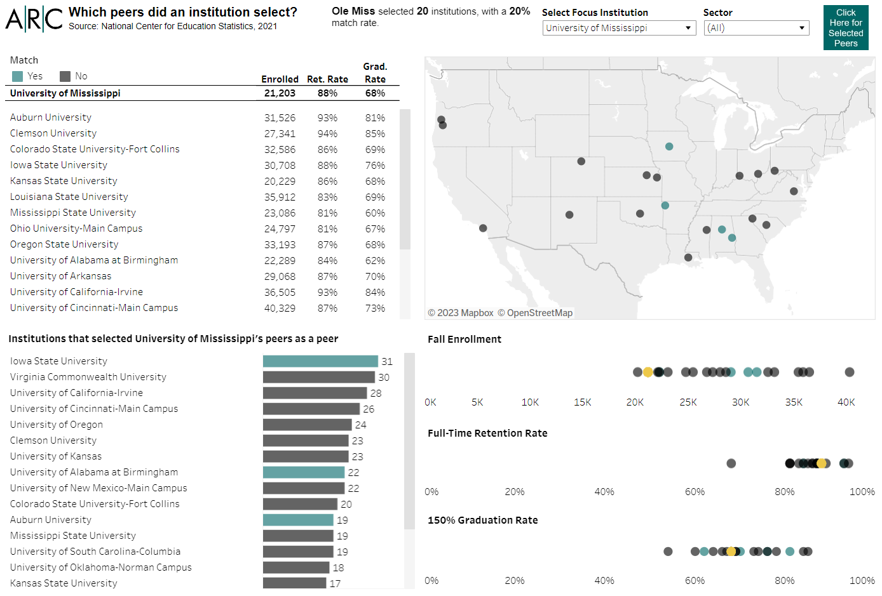
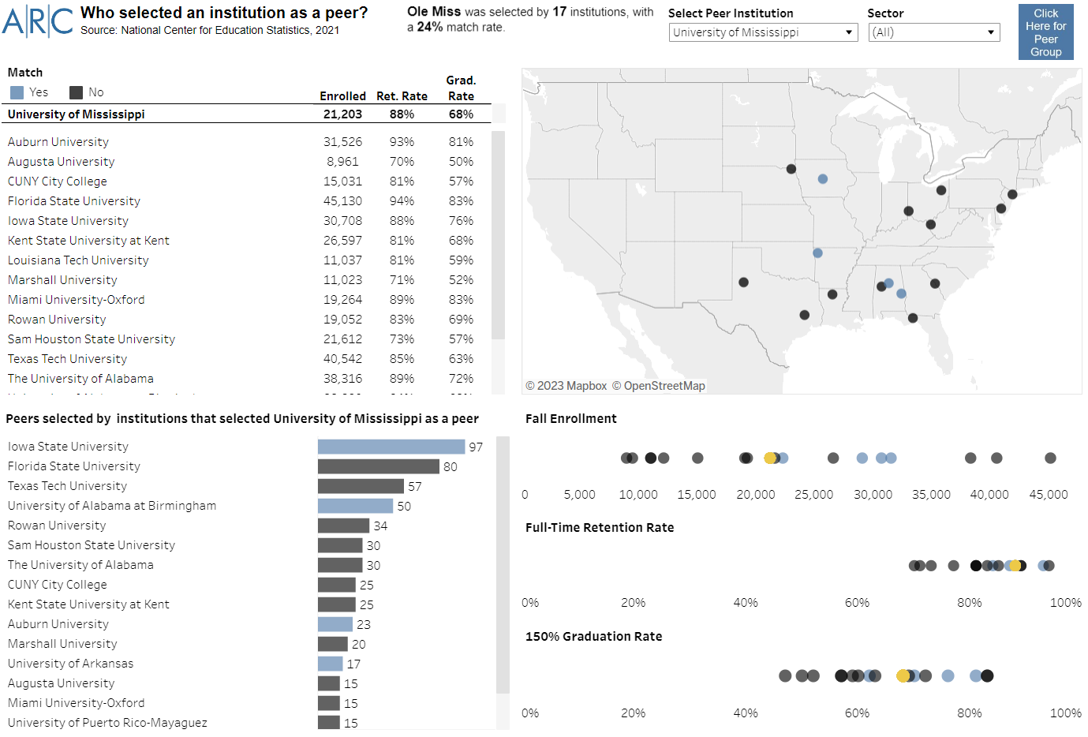
IPEDS Peer Group Comparisons
Dashboard available at https://bit.ly/IPEDSpeergroups
https://nces.ed.gov/ipeds/SummaryTables/

Slide 24
IPEDS Summary Tables Data Tool

Slide 25
IPEDS Data Tools: Summary Tables
https://nces.ed.gov/ipeds/SummaryTables/
Create a wide-range of preformatted reports for a subgroup of institutions
Include both aggregate and institution-level reports
Compare between national default groups, user created subgroups, and a focus institution
Select data without drilling down the IPEDS variable tree
Create race/gender tables using a standard format
Download reports into Excel pivot table formats
Create trends by institution
Create visualizations

Slide 26
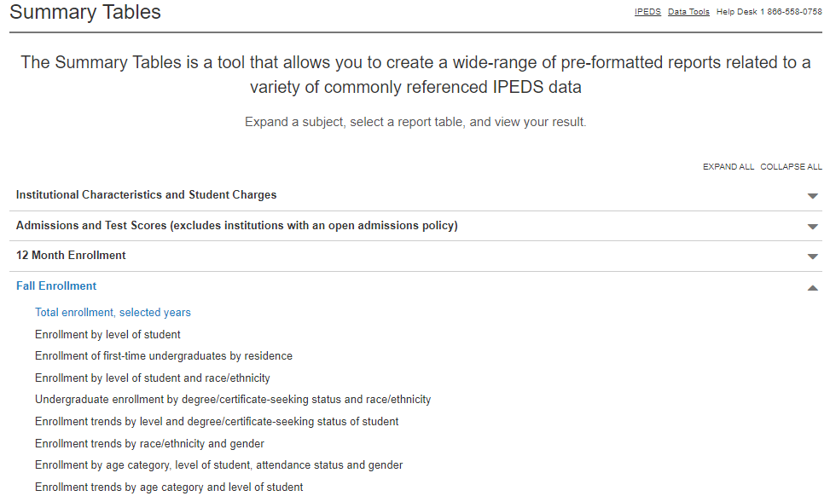
IPEDS Data Tools: Summary Tables

Slide 27
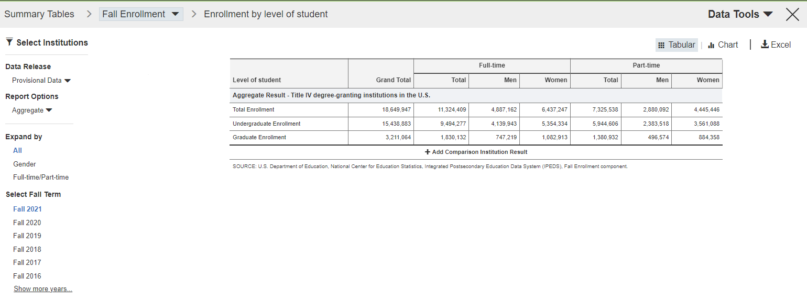
IPEDS Data Tools: Summary Tables

Slide 28
IPEDS Data Tools: Summary Tables

Slide 29
IPEDS Data Tools: Summary Tables

Slide 30
IPEDS Data Tools: Summary Tables

Slide 31
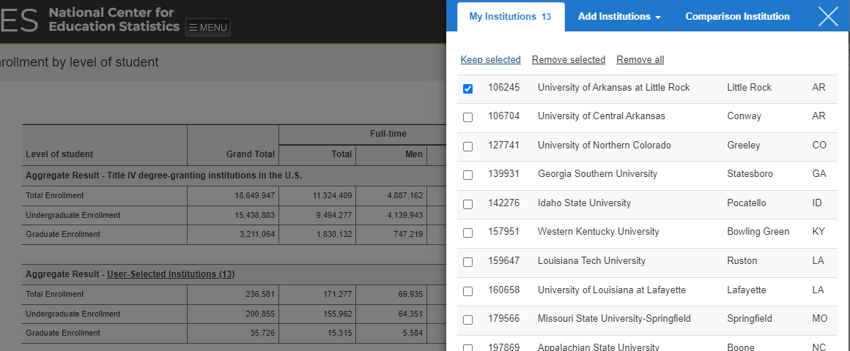
IPEDS Data Tools: Summary Tables

Slide 32
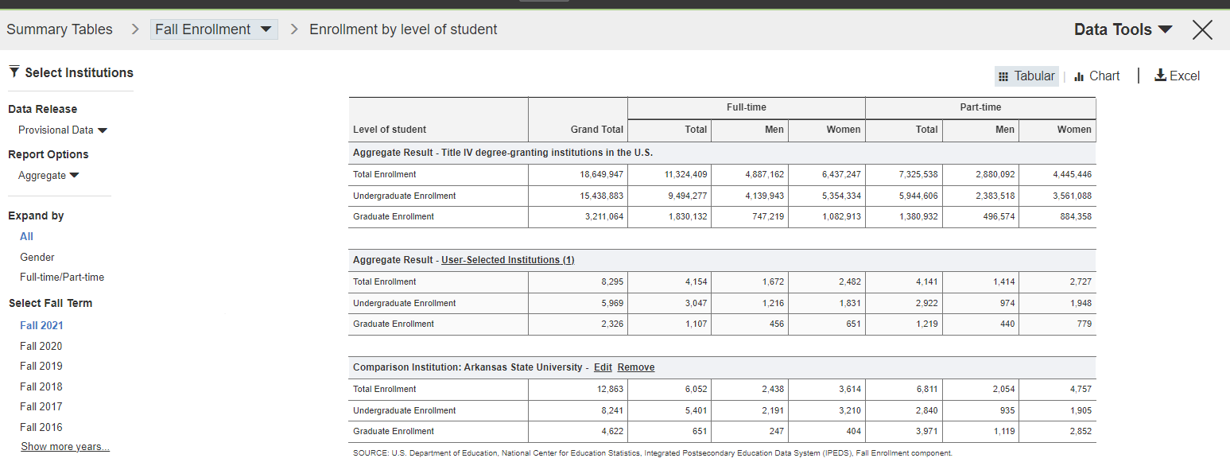
IPEDS Data Tools: Summary Tables

Slide 33
Questions?
Slides available at https://ark-ir.org

